Slide 1
WIDE QRS TACHYCARDIA
BY ANKUR KAMRA

Slide 2
Wide QRS complex tachycardia is a rhythm with a rate of ≥100 b/m and QRS duration of ≥ 120 ms
LBBB morphology-QRS complex duration ≥ 120 ms with a predominantly negative terminal deflection in lead V1
RBBB morphology-QRS complex duration ≥ 120 ms with a predominantly positive terminal deflection in V1

Slide 3
WQRS TACHYCARDIA CAUSES
Ventricular tachycardia
Antidromic reciprocating tachycardia
Supraventricular tachycardias with anterograde conduction over an accessory pathway into ventricular myocardium.
Supraventricular tachycardia with aberrancy.
Orthodromic reciprocating tachycardia with BBB
Tachycardia using nodo or atrio fasicular fibers
Reciprocating tachycardia with anterograde conduction over one AP and retrograde over other AP

Slide 4
Hyperkalemia
Hypermagnesemia
Pacemaker-generated beat
Hypothermia
Drug Toxicities (tricyclic antidepressants, cocaine,
phenothiazines, lithium, diphenhydramine, or other drugs having sodium channel blockade or quinidine-like effects)
ECG artifact

Slide 5
Antidromic tachycardia
Antidromic AVRT – anterograde conduction over the accessory pathway and retrograde conduction over the AV node .
On ECG, QRS is wide due to an early depolarization .
Only about 5% of the tachycardia in patients who have WPW syndrome are antidromic, remaining 95% are orthodromic.

Slide 7
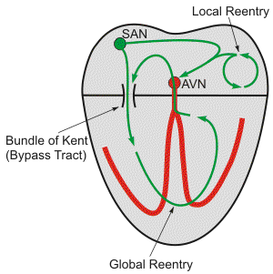
2. SVT by bystander
Any SVT with anterograde conduction down an accessory pathway which act as an innocent bystander will produce a wide QRS.

Slide 8
3. Supraventricular tachycardia with aberrancy.
Aberration is defined as abnormal interventricular conduction of supra ventricular impulse.

Slide 9
aberrancy
Two important prerequisite are:-
unequal refractory period
critically timed premature impulse
Any SVT can present typical with BBB morphology in patients with a preexisting (baseline) BBB or functional BBB aberration.

Slide 10
Functional BBB
Aberrant complex results
when depolarization wave fall on refractory period of bundle branch caused by previous complex .
2. May also result from concealed retrograde penetration (e.g. from a premature ventricular contraction ) into bundle branch making it refractory to subsequent beats.

Slide 11
What favors
Ashman phenomena
Duration of refractory period is directly proportional to preceding RR interval
So RP shortens with tachycardia and prolongs with bradycardia.
When preceding RR interval is short, subsequent RP of bundle branch is short so an early beat will found both recovered and conducted normally.
While AF, marked sinus arrhythmia, blocked atrial extrasystole there is sudden prolongation of ensuing RP. This may result in delay or block in conduction.

Slide 12
HOW IT MAINTAINS
The tendency of functional bundle branch block, to continue itself, once established during a sudden rate increase is known as linking.
It is sustained during successive beats because of repeated transseptal retrograde concealed penetration by impulses traversing contra lateral bundle branch.

Slide 13
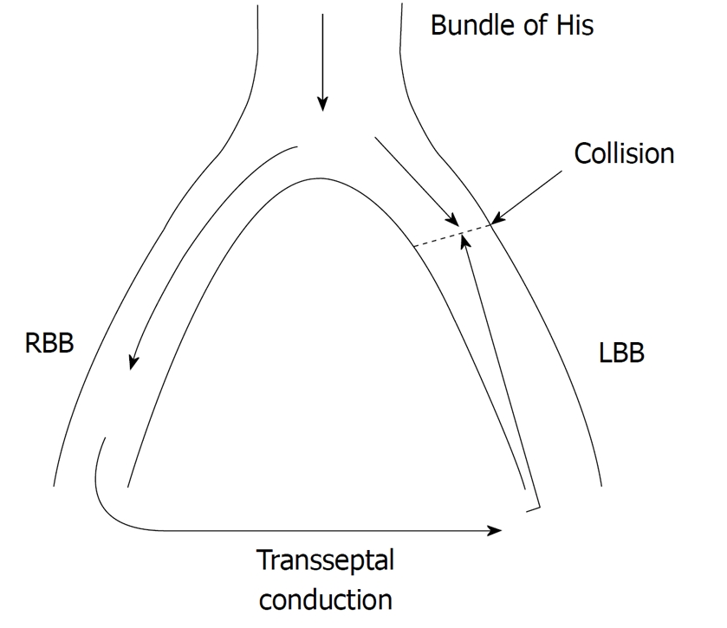

Slide 14
4. Tachycardia using nodo or atrio fasicular fibers
Atriofascicular fibers originate in right atrial free wall and insert into distal part of RBB.
These fibers are functionally similar to that of AV node
Commonly anterograde conduction down the bypass tract and retrograde via the normal conduction system.
Orthodromic AVRT never occurs.

Slide 15
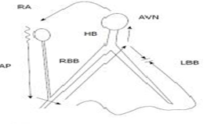

Slide 16
5. Orthodromic tachycardia with BBB

Slide 17
APPROACH

Slide 18
HISTORY
One small retrospective study found that histories of prior MI, CHF and recent angina pectoris all had positive predictive values for VT greater than 95% but sensitivities were low to moderate.
Patient age older than 35 years suggests VT. Patient age younger than 35 years supports PSVT with sensitivity and positive predictive value of only 54% and 70% respectively.
Baerman JM, Morady F, DiCarlo LA, de Buitleir M. Differentiation of ventricular tachycardia from supraventricular tachycardia with aberration: Value of clinical history. Ann Emerg Med. 1987;16:40-43.
Notes:
Baerman JM, Morady F, DiCarlo LA, de Buitleir M. Differentiation of
ventricular tachycardia from supraventricular tachycardia with aberration:
Value of clinical history. Ann Emerg Med. 1987;16:40-43.

Slide 19
History of pacemaker or ICD -Increased risk of ventricular tachyarrhythmia
History of medication-
Drug-induced tachycardia - Torsade de pointes
Digoxin-induced arrhythmia if ≥2ng/l or normal if hypokalemia
Duration of the tachycardia — SVT is more likely if the tachycardia has recurred over a period of more than three years

Slide 20
Physical examination
AV dissociation
Physical signs include
irregular cannon A waves
varying intensity of the S1 heart sound
beat-to-beat variability in systolic blood pressure.
Notes:
Irregular cannon A waves occur when the atria contract against AV valves that are closed because the ventricles are simultaneously ontracting. These waves are the result of brisk blood backflow in the jugular veins. They do not occur with each cardiac cycle, and may be variable in quality because atrial contraction may occur when the AV valves are open or in differing stages of closure. This results in irregularity and varying quality of the cannon A wave intensity, when and if these waves occur. Varying intensity of the S1 heart sound is related to the timing of AV valve closure at the onset of ventricular systole. The beat-to-beat variability of the first heart sound’s loudness is due to the varying positions of the AV valves at the onset of ventricular systole. Beat-to-beat variability in SBP is due to the changing amount of blood in the ventricle during ventricular contraction, the result of varying diastolic filling times

Slide 21
Overall heart rate due to SVT is slightly faster than VT.
The most important point is hemodynamic status.
A survey of physicians published in JAMA in 1985 demonstrated this fact was commonly misunderstood.
Neither patient heart rate nor hemodynamic status is much useful.
Notes:
Morady F, Baerman JM, DiCarlo LA, et al. A prevalent misconception
regarding wide complex tachycardias. JAMA. 1985; 254:2790-2792.

Slide 22
Carotid sinus pressure
Sinus tachycardia will gradually slow with carotid sinus pressure and then accelerate upon release.
Atrial tachycardia or atrial flutter-the ventricular response will transiently slow. Arrhythmia is unaffected.
Paroxysmal SVT frequently terminates with carotid sinus pressure.

Slide 23
VT
Unaffected by vagal maneuvers such as carotid sinus pressure or valsalva
May slow or block retrograde conduction.
Exposes AV dissociation

Slide 24
Regularity
Marked irregularity of RR interval occurs in
atrial fibrillation (AF) with aberrant conduction and polymorphic VT

Slide 25
ECG

Slide 26
Difference b/w svt vs vt
Relation of abnormal QRS with preceding atrial event-
QRS preceded by p normally reflects aberrant conduction.
if not present it represent ventricular ectopic.
Drawback – AF, AV nodal, ventricular tachycardia with retrograde conduction.

Slide 27
2. AV dissociation
Is the most useful criteria.
Complete AVD is seen in 20-50% of all VTs and practically no SVTs.
Clue to presence of AVD is variation in QRS amplitude (p on QRS).
30% of VTs have 1:1 retrograde conduction.

Slide 28
3. Capture beat with normal or near normal QRS favors VT
4. Fusion complex –
Best sign for VT.
By activation of ventricles by supraventricular and ventricular impulse.
Imply presence of AVD (seen during slow tachycardias).

Slide 29
5. Characteristic of QRS appearances
During a normally conducted beat right ventricle does not participate in initial ventricular depolarization
Aberrant ventricular conduction is mostly RBBB pattern
So initial portion of the QRS complex is not affected by RBBB aberration because conduction is occurring normally as LBB is unaffected.

Slide 30
RBBB
QRS complex of RBBB characteristically has triphasic configuration rsR in lead V1 and q RS in V6
While VPC have monophasic or diphasic configuration in lead V1 or V6 with dominantly downward or upward deflection.

Slide 31
LEAD V1 and V6
If with RBBB pattern:
In V1:
During aberration there is no change in initial portion of QRS so we see r S r’ , r R’ , rsr’ or r SR’.
During VT monophasic R wave, broad (> 30 msec) R followed by terminal negative QRS and qR.

Slide 32
RBBB V6
In V6 :During aberration q Rs, Rs or RS (with R/S ratio >1 i.e. r > s) reflecting ventricular activation over the LBB.
In VT we may see r S, Qrs , QS or QR or monophasic R wave. If RS pattern is present R/S less than 1 i.e. r<s .

Slide 33
LBBB
Left bundle branch mediates ventricular depolarization during normally conducted complex so LBBB would be expected to cause Change in initial vector.
But there is rapid penetration of LV His-Purkinje system even in presence of LBBB so initial vector forces preserved.
So during LBBB aberration either r S or QS is present in V1 but in either case with rapid initial forces (narrow r wave and rapid, smooth descent to the nadir of S wave)

Slide 34
LBBB V1
In VT lead V1 (and also V2) shows:
An initially positive QRS with positivity measuring more than 30 mseconds
Slurring or notching of the downstroke of the S wave
An interval between the beginning of the QRS and the nadir of the S wave of 70 mseconds or more

Slide 35
LBBB SHAPE
In V6 :In aberrancy there is no initial Q wave and we see RR’ or monophasic R.
During VT common patterns are QR ,QS ,Q r S or Rr’

Slide 36
V1 V6
Normal
conduction
SVT with
aberration
VT
LBBB RBBB LBBB RBBB

Slide 37
6. Presence of QR complexes
Coumel and colleagues found significance of a QR (but not a QS) complex.
Presence indicates a scar in myocardium usually caused by myocardial infarction.
QR complexes during VT are present in approximately 40% of VTs after myocardial infarction.

Slide 38
PSEUDO Q WAVE
Some cases of dilated cardiomyopathy may have Q waves during VT
It rarely occur in some SVT-As (such AV nodal reentry with retrograde P wave deforming onset of QRS, mimicking a Q wave)
Preexcited tachycardia in which a posterior AV connection is used for ventricular activation (resulting in pseudo inferior Q waves)

Slide 39
7. Concordance
Concordance is present when the QRS complexes in all six precordial leads (V1 through V6) are monophasic with the same polarity.
Either -entirely positive with tall, monophasic R waves or entirely negative with deep monophasic QS complexes.
If any of the six leads has a biphasic QRS (qR or RS complexes) concordance is not present.

Slide 40
Concordance
Negative concordance is diagnostic for a VT arising in the apical area of the heart .
Positive concordance means that ventricular activation starts left posteriorly.
Positive concordance can be found either in VT originating in left posterior wall or during tachycardias using a left posterior accessory AV pathway for AV conduction.

Slide 41
Concordance
Specificity of a concordant pattern for VT is high (greater than 90%), its sensitivity is low
Concordance is observed in only apoximately 20% of all VTs, equally divided between positive and negative patterns.

Slide 42
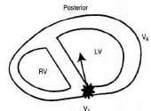
Negative concordance

Slide 43
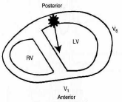
Positive concordance

Slide 44
Concordance of limb leads
Presence of predominantly negative QRS complexes in leads 1, 2 and 3 also suggested as a criterion for diagnosing VT.
This is another way of describing rightward superior axis

Slide 45
8. Axis
A right superior axis (axis from -90 to ±180º)- “northwest" axis strongly suggests VT .
Compared to axis during sinus rhythm, axis shift during the WCT of more than 40º suggests VT .
In a patient with a RBBB-like WCT, QRS axis to left of -30º suggests VT.
In a patient with an LBBB-like WCT, a QRS axis to right of +90º suggests VT .

Slide 46
9. QRS duration
QRS complex width of >0.14 sec with right bundle branch block morphology are suggestive of VT.
QRS complex width of >0.16 sec with left bundle branch block morphology are suggestive of VT.
A QRS duration <140 msec does not exclude VT
( VT originating from the septum may be associated with a relatively narrow QRS complex)

Slide 47
An SVT can have a QRS width of more than 0.14 (RBBB) or 0.16 (LBBB) seconds-
In presence of preexistent BBB in elderly with fibrosis in bundle branch system and ventricular myocardium
When during SVT AV conduction occurs over an accessory AV pathway
When class IC drugs (especially flecainide), hyperkelemia are present during SVT.

Slide 48
OTHER IMPORTANT POINTS
WCT with QRS narrower than NSR is strongly in favor of VT.
Contralateral BBB in NSR and WCT strongly suggests VT.

Slide 49
ALGORITHMS

Slide 51
In 1965 Sandler and Marriott first to differentiate between VEB vs RBBB like morphology
They found that 92% of VEB with RBBB morphology have a monophasic or biphasic pattern in lead V1, whereas a triphasic pattern (rsR′, rSR′, RsR′) was only found in 6% of VEB
They also noticed that concordant precordial pattern.
Marriott in 1971 gave term ‘Rabbit ears’ for a double peaked R-wave in lead V1 with peak more then second favoring VT.
Notes:
Ventricular ectopic beat

Slide 52
In 1978 Wellens used His bundle recording for the first time to determine the site of origin of tachycardia so known as classical criteria.

Slide 54
Kindwall’s (1988) ECG criteria for VT in LBBB
1. R wave in V1 or V2 of >30 ms duration
2. Duration of >60 ms from the onset of the QRS to the nadir of the S wave in V1 or V2
3. Notching on the downstroke of the S wave in V1 or V2
4. Any Q wave in V6

Slide 57
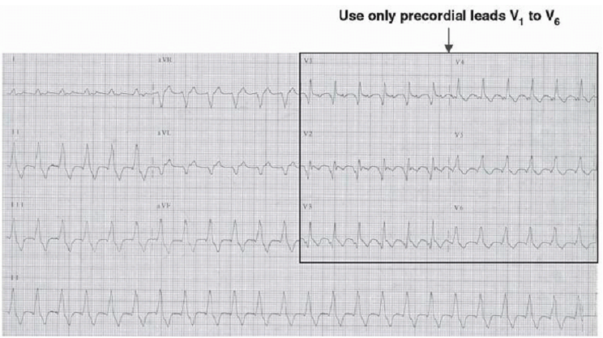
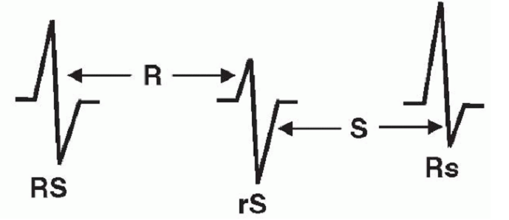
STEP1

Slide 58
STEP 2

Slide 59
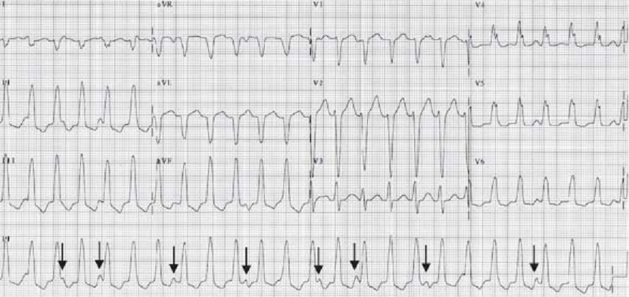
Step 3

Slide 60
V1 in LBBB type QRS
VT
R >30 msec, QRS onset to S nadir>70 msec
Notching and slurring of QRS complex –myocardial disease
True LBBB
R-R duration < 30 msec
Interval from QRS onset to S nadir ≤70 msec

Slide 61
V6 in LBBB type QRS
True LBBB
Monophasic R with slow upstroke
VT
qR or QS pattern

Slide 62
Step 4: LBBB - type wide QRS complex
SVT
VT
R wave >30ms
small R wave
notching of S wave
V1
fast downslope
of S wave
> 70ms
V6
Q wave
no Q wave

Slide 63
V1 in RBBB type QRS
Initial ventricular activation is independent of RBB.
RBBB abberation affects only the latter QRS
True RBBB
rR’,rsR’,rSr’,rSR’
VT
qR,Rsr’,monophasic R wave

Slide 64
V6 in RBBB type QRS
RBBB abberation-small s wave.
qRs or Rs pattern
RBBB type VT-
qRS,qrS,rS,QS patterns seen

Slide 65
Step 4: RBBB - type wide QRS complex
SVT
VT
rSR’ configuration
monophasic R wave
qR (or Rs) complex
V1
or
R/S > 1
R/S ratio < 1
QS complex
V6
or

Slide 69
In 2007 Vereckei proposed algorithm. This also consists of four steps:
If AV dissociation is present diagnosis of VT is made and analysis stopped.
If an initial R wave is present in lead a VR- VT is made and analysis stopped
If morphology of wide QRS tachycardia does not correspond to BBB or fascicular block diagnosis of VT is made and analysis is stopped.
In the last step when the initial (vi) and terminal (vt) ventricular activation velocity ratio (vi/vt) is ≤1, diagnosis of VT is made if vi/vt is >1, the diagnosis is SVT is made.

Slide 70
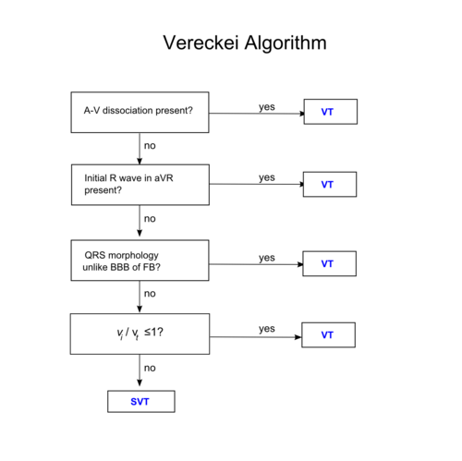
Vereckei A, Duray G, Szénási G, Altemose GT, and Miller JM. Application of a new algorithm in the differential diagnosis of wide QRS complex tachycardia. Eur Heart J 2007 Mar; 28(5) 589-600.

Slide 71
The vi/vt ratio
During SVT initial activation of the septum is rapid and conduction delay occurs in the mid to terminal part of the QRS.
So initial velocity faster than that of later or terminal
During VT initial slower ventricular spread of activation occurs until impulse reaches His-Purkinje system after which ventricular muscle is rapidly activated.

Slide 72
So vi/vt ratio is calculated by measuring voltage change on the ECG tracing during first 40 ms (vi) and the last 40 ms (vt) of same QRS complex.
vi/vt ratio of ≤1 is suggestive of VT and vi/vt ratio of >1 of SVT.

Slide 73
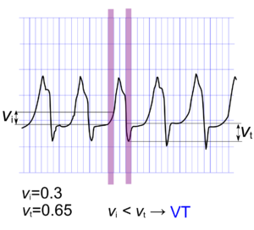

Slide 75
Sensitivity Specificity PPV NPV
Brugada 89% 73% 92% 67%
Vereckei 97% 75% 93% 87%
Vereckei A, Duray G, Szénási G, Altemose GT, and Miller JM. Application of a new algorithm in the differential diagnosis of wide QRS complex tachycardia. Eur Heart J 2007 Mar; 28(5) 589-600.

Slide 76
In 2008 Vereckei et al. proposed another new algorithm based on the direction and velocity of initial and terminal ventricular activation
it also consists of four steps

Slide 77
Why new
Selection of lead aVR - make it simple
Classification of VT into two main groups:
VT arising from apical region of ventricle- initial R wave in lead aVR
VT arising from other regions- lacking an initial R wave in aVR but with slowing of the initial part of the QRS complex so v_{i} / v_{t} < 1
Elimination of the AV dissociation criterion.

Slide 78
aVR algorithm
Criteria looks ONLY at lead aVR (if answer is yes, then VT):
1. Is there an initial R wave?
2. Is there a r or q wave > 40 msec
3. Is there a notch on the descending limb of a negative QRS complex?
4. Measure the voltage change in the first (v_{i}) and last 40 msec (v_{t}).
v_{i} / v_{t} < 1?
Senstivity and specficity of this is 88% and 53%.
Vereckei et al, Heart Rhythm 2008

Slide 80
Ultrasimple Brugada criterion
Joseph Brugada - 2010
R wave peak time in Lead II
Rationale for this criterion is that conduction is slower in myocardial tissue than via His-Purkinje system so it can be used to distinguish a ventricular from supraventricular
Duration of onset of the QRS to the first change in polarity in lead II.
If the RWPT is ≥ 50ms the likelihood of a VT very high (positive likelihood ratio 34.8)
Pava LF, Perafán P, Badiel M, Arango JJ, Mont L, Morillo CA, and Brugada J. R-wave peak time at DII: a new criterion for differentiating between wide complex QRS tachycardias. Heart Rhythm 2010 Jul; 7(7) 922-6.

Slide 83
Most specific criteria in sequence: When one criterion is met diagnosis is made-
Step 1: AV relationship (if dissociated VT; if not proceed to next step)
Step 2: Rightward superior axis (if present VT; if not proceed to next step)
Step 3: Vi/Vt ratio (if greater than 1 SVT-A is diagnosed; if not proceed to next step)

Slide 84
Step 4: Precordial RS pattern (if absent VT; if not proceed to next step)
Step 5: Precordial RS interval (if RS present and interval greater than 100 ms VT; if not proceed to next step)
Step 6: In LBBB type WCT, R wave less than 30 ms or R onset to S nadir less than 60 ms in V1 (if present SVT-A is diagnosed)

Slide 85
Finally artefact that mimics VT particularly when observed on a rhythm strip can lead to misdiagnosis.
Knight et al surveyed 221 cardiologists and 490 electrophysiologists with case simulation that included two-lead ECG monitor tracing of artefact
Found that the rhythm strip was misdiagnosed as VT by 58% of cardiologists and 38% of electrophysiologists.

Slide 87
THANK YOU

Slide 88
SUMMARY
AV dissociation suggests VT, but VA conduction may be present during VT
QRS width of > 160 ms suggests VT, but need to rule out:
– pre-existent BBB (especially LBBB)
– SVT with AV conduction over an AP
– use of drugs slowing intraventricular conduction (flecainide).
Keep in mind—VT arising close to or in the intraventricular conduction system may have a width of < 140 ms

Slide 89
SUMMARY
Left axis deviation (to the left of −30) suggests VT but is not helpful in:
– LBBB shaped QRS
– SVT with conduction over a right sided or posteroseptal AP
Right axis deviation (to the right of +90) suggests VT in LBBB shaped QRS
Concordant pattern in precordial leads suggests VT but positive concordancy may occur during SVT with AV conduction over a left posterior AP

Slide 90
SUMMARY
R nadir S > 100 ms in one or more precordial leads suggests VT, but may be found in:
– SVT on drugs slowing intraventricular conduction
– SVT with AV conduction over an AP
– pre-existent BBB (especially LBBB)
QR complexes during VT suggest previous myocardial infarction as etiology

